Slide 1
Electronic Mail

Slide 2
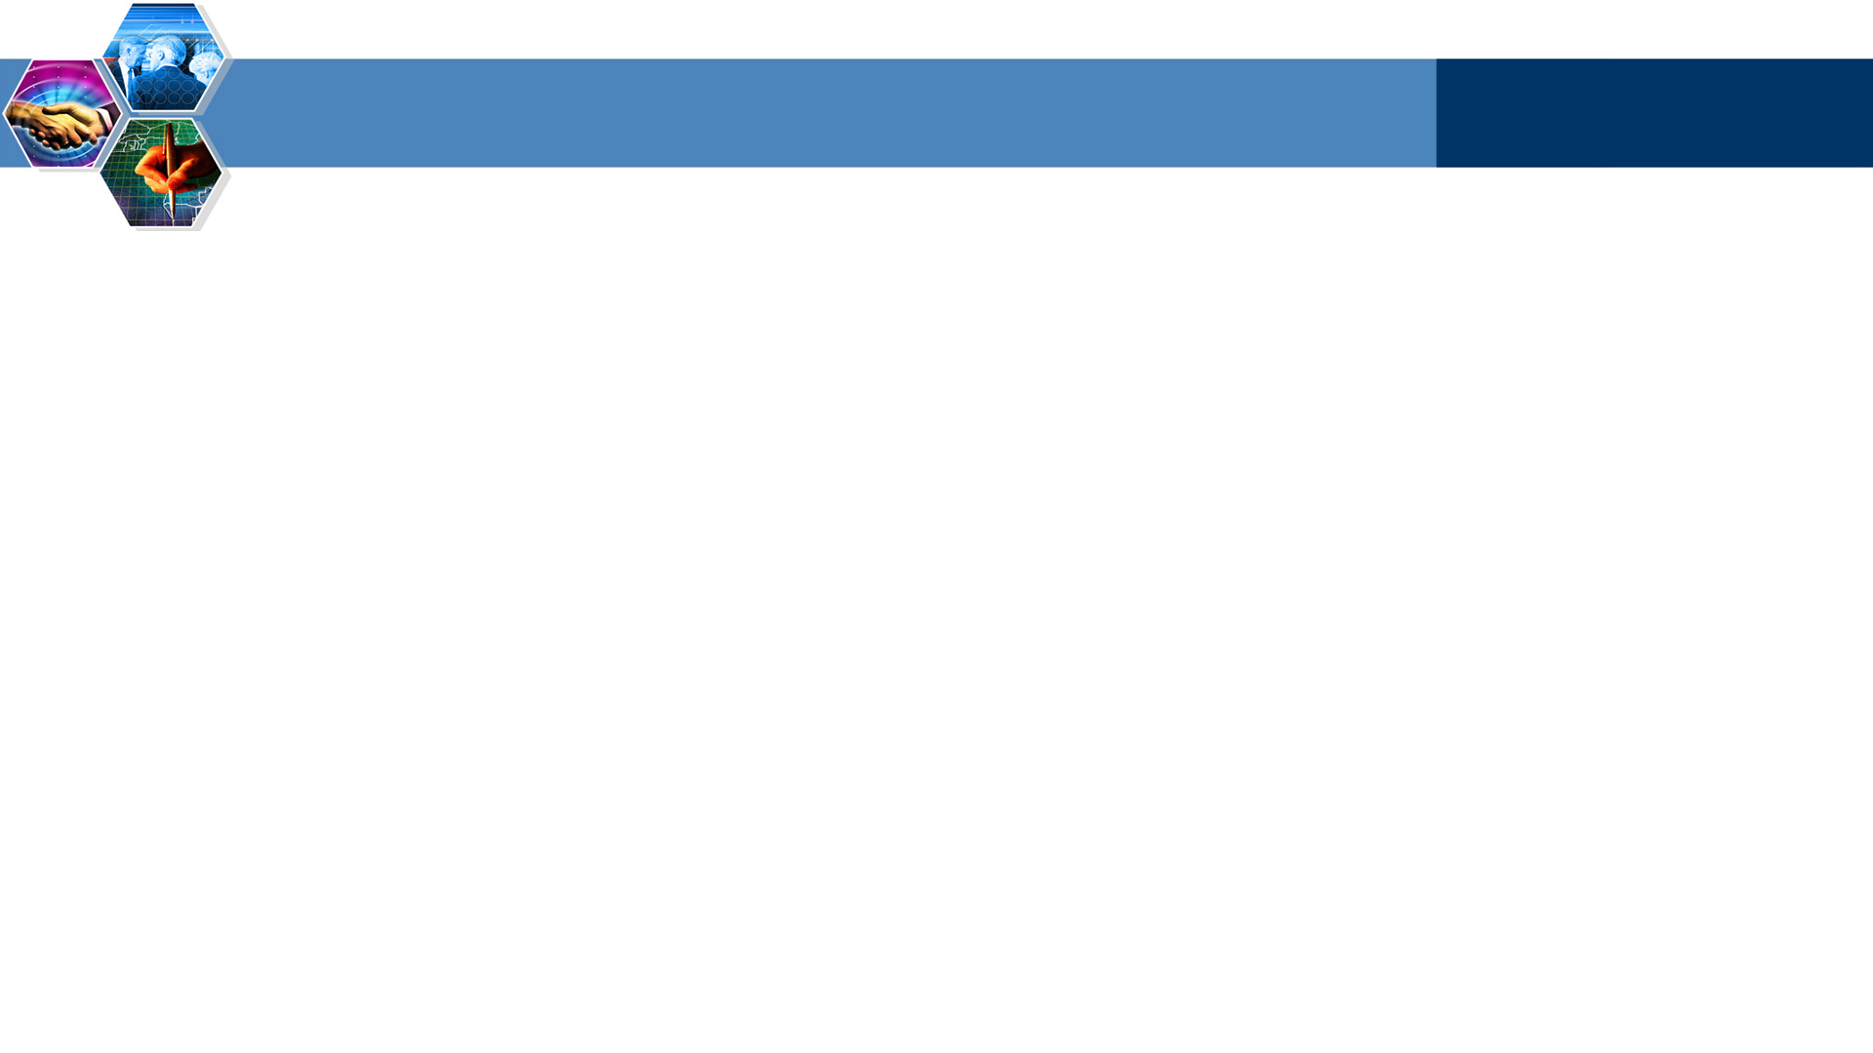
Electronic Mail
outgoing
message queue
user
agent
Three major components:
user agents
mail servers
simple mail transfer protocol: SMTP
User Agent
a.k.a. “mail reader”
composing, editing, reading mail messages
e.g., Eudora, Outlook, elm, Mozilla Thunderbird
outgoing, incoming messages stored on server
user mailbox
mail
server
user
agent
SMTP
mail
server
user
agent
SMTP
SMTP
mail
server
user
agent
user
agent

Slide 3
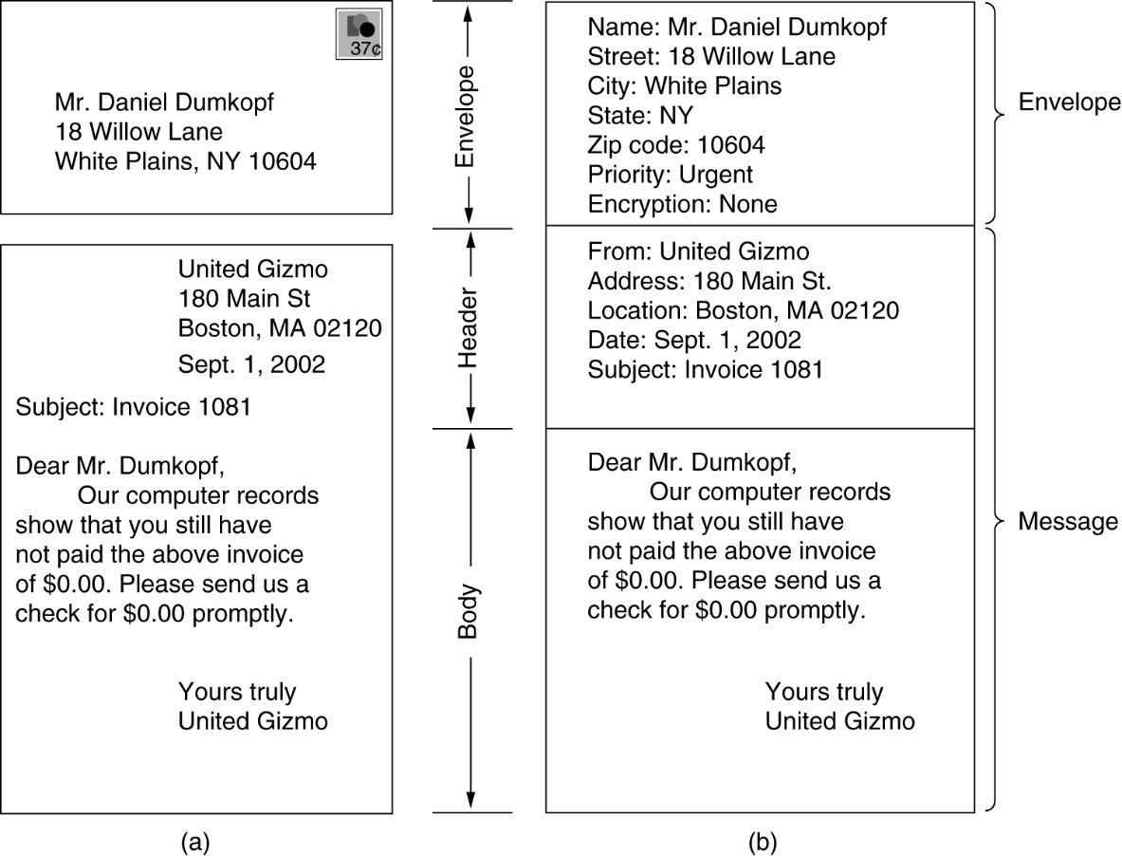
The User Agent
Envelopes and messages.
(a) Paper mail.
(b) Electronic mail.

Slide 4
Electronic Mail: mail servers
user
agent
Mail Servers
mailbox contains incoming messages for user
message queue of outgoing (to be sent) mail messages
SMTP protocol between mail servers to send email messages
client: sending mail server
“server”: receiving mail server
mail
server
user
agent
SMTP
mail
server
user
agent
SMTP
SMTP
mail
server
user
agent
user
agent

Slide 5
Electronic Mail: SMTP [RFC 2821]
uses TCP to reliably transfer email message from client to server, port 25
direct transfer: sending server to receiving server
three phases of transfer
handshaking (greeting)
transfer of messages
closure
command/response interaction
commands: ASCII text
response: status code and phrase
messages must be in 7-bit ASCII

Slide 6


Scenario: Alice sends message to Bob
1) Alice uses UA to compose message and “to”
bob@someschool.edu
2) Alice’s UA sends message to her mail server; message placed in message queue
3) Client side of SMTP opens TCP connection with Bob’s mail server
4) SMTP client sends Alice’s message over the TCP connection
5) Bob’s mail server places the message in Bob’s mailbox
6) Bob invokes his user agent to read message
1
mail
server
mail
server
user
agent
user
agent
2
3
6
4
5

Slide 7
Sample SMTP interaction
S: 220 hamburger.edu
C: HELO crepes.fr
S: 250 Hello crepes.fr, pleased to meet you
C: MAIL FROM: <alice@crepes.fr>
S: 250 alice@crepes.fr... Sender ok
C: RCPT TO: <bob@hamburger.edu>
S: 250 bob@hamburger.edu ... Recipient ok
C: DATA
S: 354 Enter mail, end with "." on a line by itself
C: Do you like ketchup?
C: How about pickles?
C: .
S: 250 Message accepted for delivery
C: QUIT
S: 221 hamburger.edu closing connection

Slide 8
SMTP: final words
Comparison with HTTP:
HTTP: pull
SMTP: push
both have ASCII command/response interaction, status codes
HTTP: each object encapsulated in its own response msg
SMTP: multiple objects sent in multipart msg
SMTP uses persistent connections
SMTP requires message (header & body) to be in 7-bit ASCII
SMTP server uses CRLF.CRLF to determine end of message

Slide 9
Mail message format
SMTP: protocol for exchanging email msgs
RFC 822: standard for text message format:
header lines, e.g.,
To:
From:
Subject:
different from SMTP commands!
body
the “message”, ASCII characters only
header
blank
line
body

Slide 10
MIME – Multipurpose Internet Mail Extensions
Problems with international languages:
Languages with accents (French, German).
Languages in non-Latin alphabets (Hebrew, Russian).
Languages without alphabets (Chinese, Japanese).
Messages not containing text at all (audio or images).

Slide 11
Mail access protocols
SMTP
SMTP
access
protocol
user
agent
user
agent
sender’s mail
server
receiver’s mail
server
SMTP: delivery/storage to receiver’s server
Mail access protocol: retrieval from server
POP: Post Office Protocol [RFC 1939]
authorization (agent <-->server) and download
IMAP: Internet Mail Access Protocol [RFC 1730]
more features (more complex)
manipulation of stored msgs on server
HTTP: gmail, Hotmail, Yahoo! Mail, etc.

Slide 12

Summary
SMTP
Mail access protocols

